Slide 1

Lecture
on
“Advanced Computer Architecture –TCS 704”
by
Akansha Gupta
DEPARTMENT OF COMPUTER SCIENCE AND ENGINEERING
GRAPHIC ERA DEEMED TO BE UNIVERSITY – 248002

Slide 2
TAXONOMY OF PARALLEL ARCHITECTURE

Slide 3
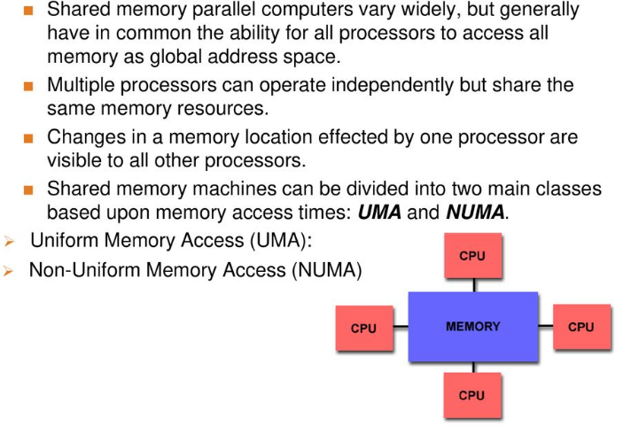
Shared Memory

Slide 4
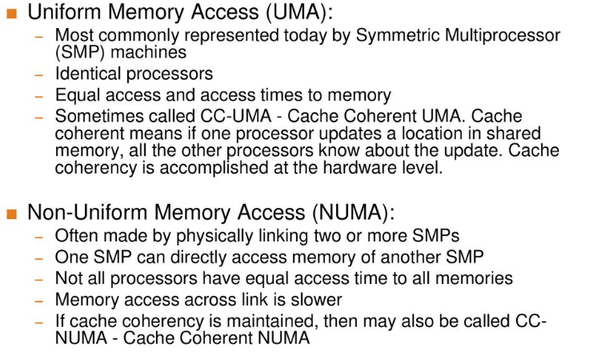
Shared Memory: UMA Vs NUMA

Slide 5
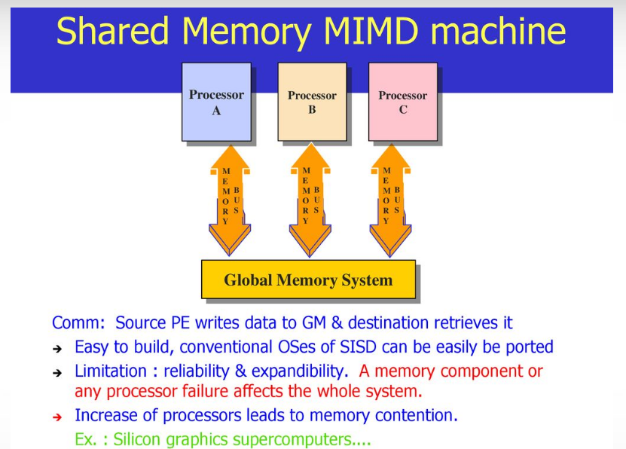

Slide 6
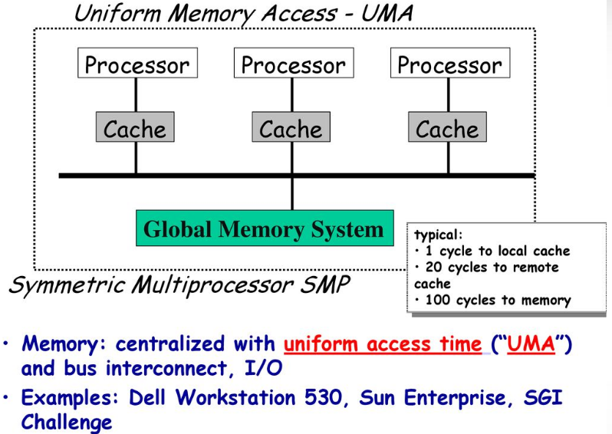

Slide 7
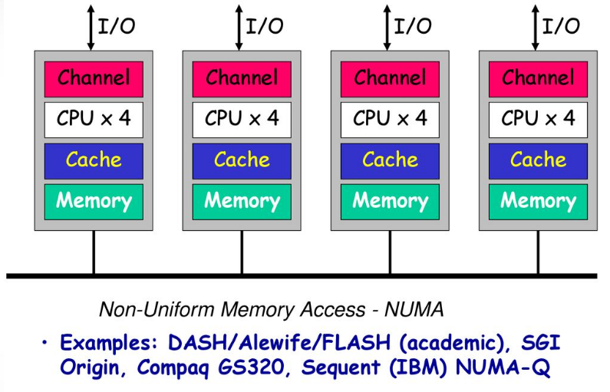

Slide 8
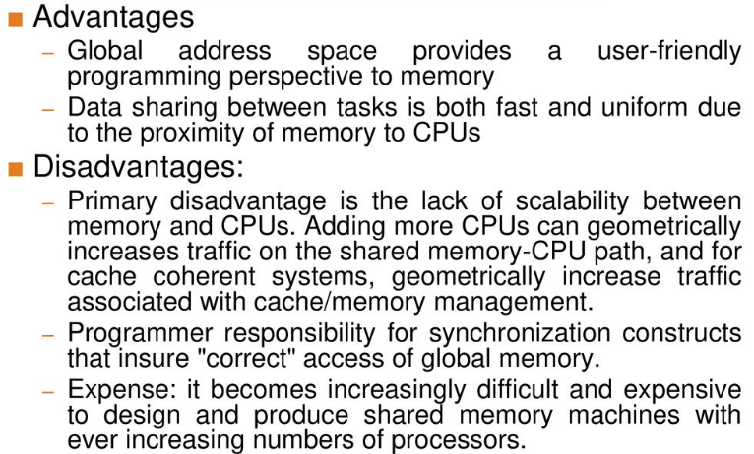
Shared Memory: Pros & Cons

Slide 9
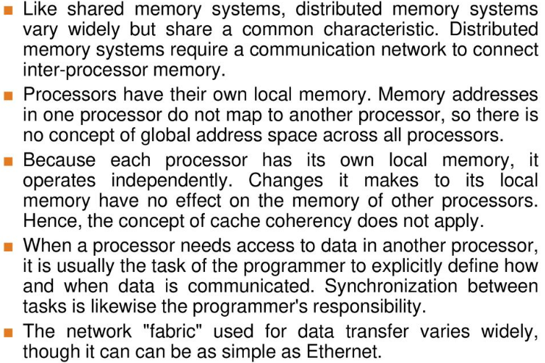
Distributed Memory

Slide 10
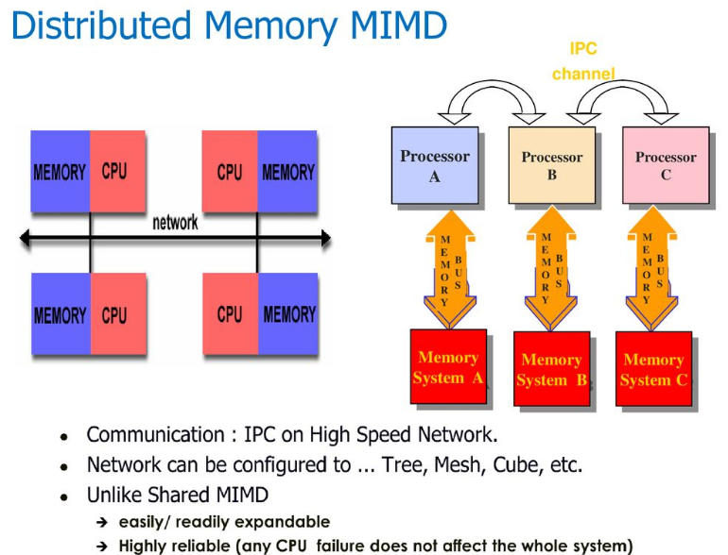

Slide 11
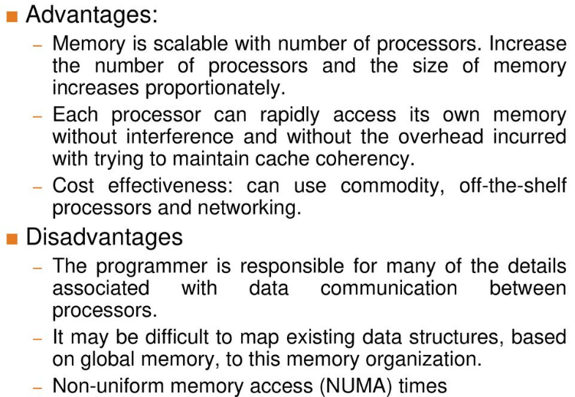
Distributed Memory: Pros & Cons

Slide 12
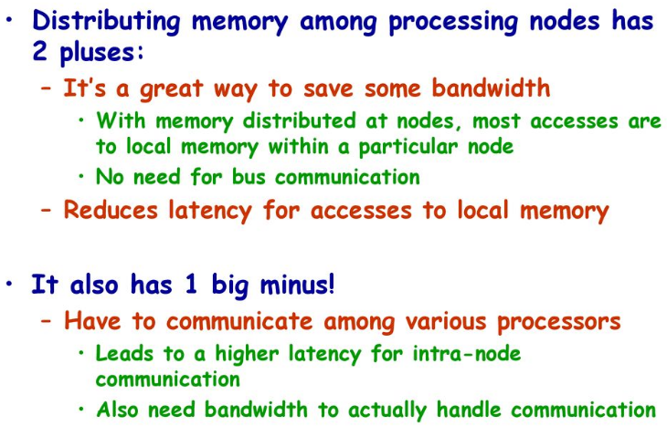

Slide 13
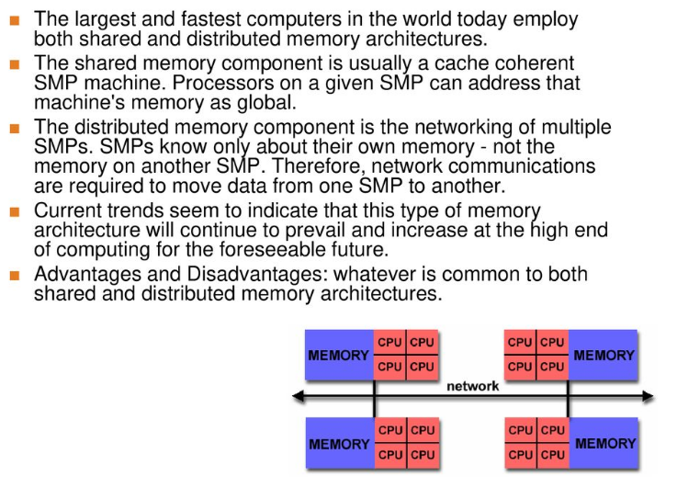
Hybrid Distributed-Shared Memory

Slide 14
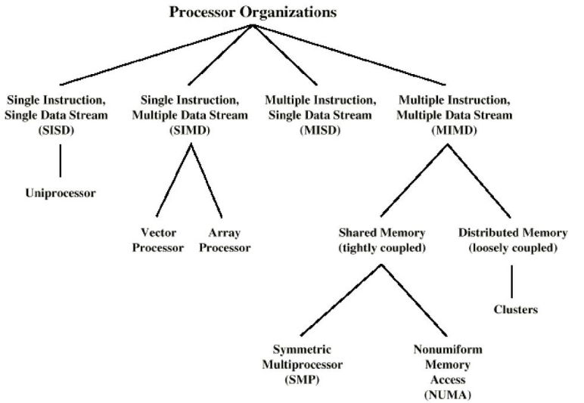
Taxonomy of Parallel Processor Architectures

Slide 15
https://youtu.be/kC_gg-diymw
THANKS

